Slide 1
Annual information meeting
Stichting Pensioenfonds
Thales Nederland
21 juni 2018

Slide 2
Agenda
Opening
Minutes of the annual information meeting of 23 juni 2017
How is the Pension Fund doing?
Interest rate hedging policy
Mission, Vision, Strategy and Integrated risk management
Pension premium and indexation 2018
Changes as of January 1, 2018
Want to participate in the supervisory committee or board?
Supervisory committee
Any other business
Closing

Slide 3
Welcome to the viewers at Huizen,
Eindhoven en Delft and at home

Slide 4
Minutes 23 juni 2017

Slide 5
How is the Pension Fund doing?

Slide 6
Coverage ratio (definition)
Assets
= coverage ratio %
Liabilities
A coverage ratio of 108% means that the pension fund has 108 euros of investments for every 100 euros that have to be paid out now and in the future.
The minimum coverage ratio is 104.2%, otherwise there is a funding shortfall;
Required (at 10-year term) is approximately 124%, otherwise there is a reserve shortage.

Slide 7
Coverage ratio Pensioenfonds Thales

Slide 8
Actual coverage ratio on May 31, 2018
Assets 1.381 mln Euro
Liabilities 1.226 mln Euro
Actual coverage ratio 112,6%
Policy coverage ratio 112,4%
(policy coverage ratio is the average of the current coverage ratios per month over the past 12 months)

Slide 9
Recovery plan
Stichting Pensioenfonds Thales Nederland has submitted a recovery plan to the supervisory authority De Nederlandsche Bank in 2015.
There is a reserve deficit (covering ratio <124%).
The recovery plan shows that the fund, with certain assumptions, has sufficient recovery power and is out of deficit within a period of 10 years (recovery plan 2018).

Slide 10
Feasibility test 2017
The aim is to provide insight into:
The consequences of the financial structure of the fund (in particular the strategic investment mix);
Expectations and risks, particularly with a view to purchasing power;
The consistency and balance of the policy;
The feasibility and consistency of the premium policy;
The recovery power of the fund.
The most important outcome that is looked at is the pension result. That is a measure of purchasing power. Note: the test has a time window of 60 years!
In 2017 it was established that the pension results from the actual financial position still fall within the set limits. Based on the coverage ratio (as at 1-1-2017), the pension result amounts to about 100% on average, but in a bad weather scenario it will be about 70%.

Slide 11
2017
 | Change with respect to 2016 +/- | Total as at 31 December 2017
Pension equity | + 39,6 mln | 1.374,6 mln
Pension obligations | - 17,2 mln | 1.217,5 mln
Number of pensioners | + 38 | 1.664
Number of active people | -10 | 1.605
Number of ex-participants | + 5 | 1.452
Cover ratio | +4,8%-punt | 112,9%
Policy cover ratio | + 5,8%-punt | 111,4%
Indexation (active people + pensioners) |  | 0,14% (1-1-2018)
Return * |  | +3,6%
(long-term) interest | 0,18%-punt | 1,45%
  * Includes Swap Overlay and currency hedging
Notes:
Paar tekst aanpassingen.
Verlaging pensioenen meer expliciet vermeld. Kan dit niet beter in aparte bladzijde ?

Slide 13
Return 2017
Return Return
Fund 2017 benchmark 2017
Equity 10,43% 10,63%
Bonds 1,88% 0,74%
Real estate funds 2,49% 1,40%
Total 4,83% 4,40%
Contribution
Swap overlay/LDI portfolio -2,37%
Currency hedging 1,12%
Total return 2017 3,58%

Slide 14
Return over period of 10 years
In % | 2017 | 2016 | 2015 | 2014 | 2013 | 2012 | 2011 | 2010 | 2009 | 2008 |  | Total 2008-2017 | Average per year 2007-2017
Total investment return* | 3,6 | 9,9 | 2,5 | 26,2 | 2,8 | 15,6 | 8,3 | 11,6 | 12,1 | -7,9 |  | 118,3 | 9,12
Total investment return (unhegded) | 4,8 | 6,07 | 5,3 | 13,1 | 6,5 | 12,4 | -0,9 | 9,1 | 16,9 | -15,0 |  | 70,3 | 5,47
Benchmark (unhegded) | 4,4 | 6,45 | 4,3 | 13,9 | 5,2 | 12,6 | -0,5 | 8,2 | 13,9 | -15,6 |  | 61,9 | 4,93
* Total investment return concerns the return including the effect of currency hedging and swap overlay / LDI (swap overlay since March 2008).

Slide 15
How much does our pension fund cost?
    Execution costs 2017 Stichting Pensioenfonds Thales NL:
    Asset management 67 basis points (0.67%) of the average invested capital (total costs 9.0 million Euro).
    Pension management 363 Euro per active member and pensioner (total costs 1.2 million Euro).
    Conclusion:
    Cost level is in line with funds of comparable size.
    (based on the Kasbank benchmark 2016)

Slide 16
Adjustments to investments in 2017
Adjustments of strategic investment policy as a result of the (mandatory) Asset Liability Management (ALM) study.
More dynamic interest rate hedging policy (hedging remains between 50% and 80%). A scale is used as a guideline whereby the level of hedging depends on market interest rates and policy coverage ratio. In 2017, the hedge was reduced in two steps: from 70% to 65% to 60%.

Slide 17
Mission, Vision and Strategy and Integrated Risk Management
In order to identify risks, a coordinated mission, vision and strategy are required. These were re-established in 2017 and agreed with stakeholders.
In short, our strategy is: SPTN puts in continuity and directionality. The board continuously pays attention to communication with the (former) participants and the pension beneficiaries and to the investment policy and the results thereof. To this end, it has set up a communications, an integrated risk management and an investment advisory committee. The effectiveness of the policy is continually monitored and acknowledged by the board in collaboration with the (internal) supervisory committee and an external visitation committee. The supervisory committee is seen as a sounding board and among other things as a breeding ground for the board.
Started with integral risk management.
SPTN and its service providers comply with the General Data Protection Regulation (AVG) on 25 May 2018.

Slide 18
Pension administration
As of 1 December 2017, Aon Hewitt sold its pension administration business to RiskCo
The Board has decided to explore the market for pension administration service providers and has put out a tender in the market.
The tender process is still ongoing, making the choice and possible transition to another service provider will take place before 1 January 2019.

Slide 19
What do I now notice about the pension fund?
Pension premium and indexation 2018

Slide 20
Premium 2018
Fixed premium for 2016-2020 :
Adjustment of pension scheme: target retirement age adjustment from 67 to 68 years led to an adjustment of the premium to 27.1%.
(distribution 60% for the employer, 40% for the employee)
The difference between the cost-effective premium and the actual premium is added to the premium equalization reserve (up to a maximum of € 5 million). Premium equalization reserve amounts to a maximum of € 5 million per end of 2017. Any surplus will go to general funds, as already occurred in 2017.

Slide 21
Indexation 2018
    In December 2017, the Board decided to grant partial indexation on 1 January 2018:
    Based on legislation, indexation can be granted with a policy coverage ratio of > 110%.
    The policy coverage ratio at the end of December was estimated at 111.4%.
    Complete indexation (price index, CPI derived) would amount to 1.36% as of 1 January 2018
    The granted partial indexation is 0.14%.
    This means a break in the trend compared to the past few years!

Slide 22
Changes as of January 1, 2018

Slide 23
Pension Scheme Amendment 2018
Legal adjustment of the standard retirement age to 68 years
(retirement date is free to choose, between 55 years and 5 years after the AOW date).
Built-up retirement pension converted to 68 years (entitlements have been increased actuarial neutral by 6.3%).
Pension from the age of 68 is slightly less expensive than pension from the age of 67 (applies to accrual as of 2018).
Use the pension planner to gain insight into your pension situation, even if you are still far away from it (pension planner is up-to-date).
Overview (UPO) based on the standard retirement age of 68 years was sent early June.

Slide 24
Want to participate in the supervisory committee or board?

Slide 25
Questions?
Also by mail: Pensioenfonds@nl.thalesgroup.com

Slide 26
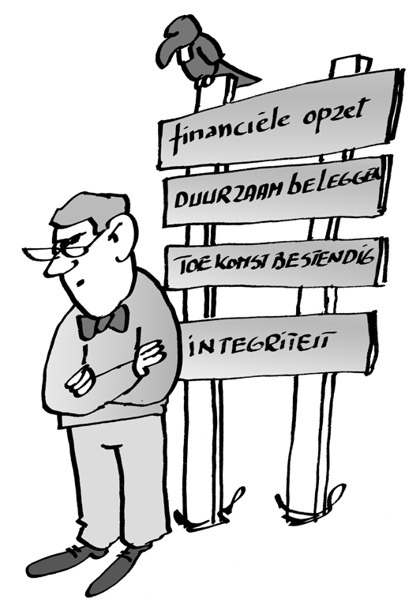

Supervisory Committee report for 2017
Edward Weening

Slide 27
Subjects
What does the Supervisory Committee (VO) do?
The composition of the Supervisory Committee (VO)
Annual report of the Supervisory Committee for 2017
Activities 2017
Preview 2018

Slide 28
What does the Supervisory Committee (VO) do?
The board is legally obliged to render account to the VO about the policy and the way in which it has been implemented
According to the Pensions Act, the VO has to give an opinion on:
  the actions of the board,
  the policies implemented and
  the policy choices for the future
  The VO records its findings in an annual report that is included in the annual report of the SPTN board
  It can advise the Board solicited and unsolicited about the policy and the implications for the participants

Slide 29
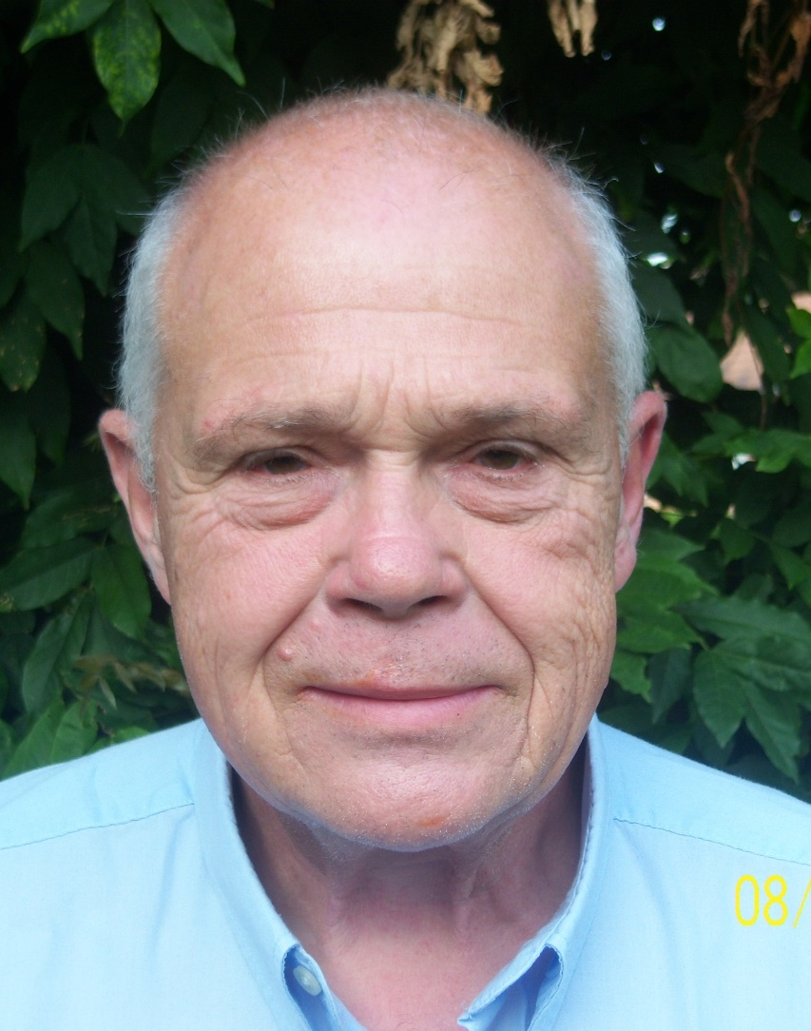
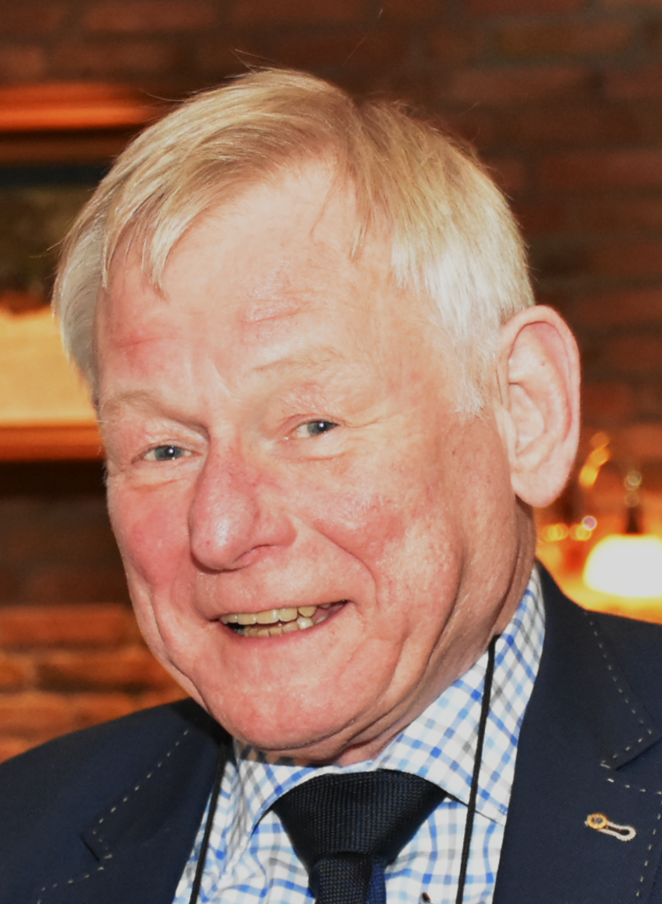
Members of the Supervisory Committee (VO)
On behalf of the pensioners
  Otto van der Zeeuw
  (since 2012)
  Jan van Rijn
  (since 2016)

Slide 30
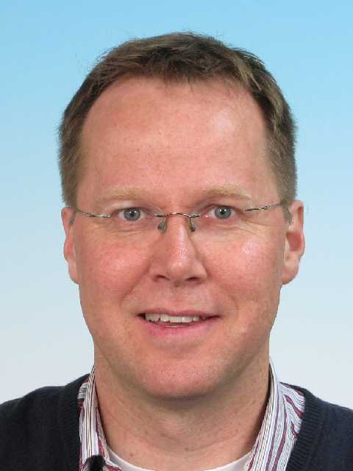
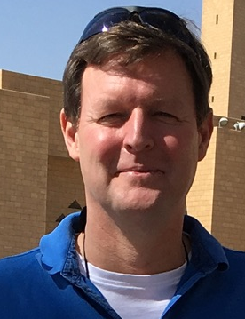
Members of the Supervisory Committee (VO)
On behalf of the Employees
  Jos van Deemter
  (since 2016)
  Edward Weening
  (since juni 2017)

Slide 31
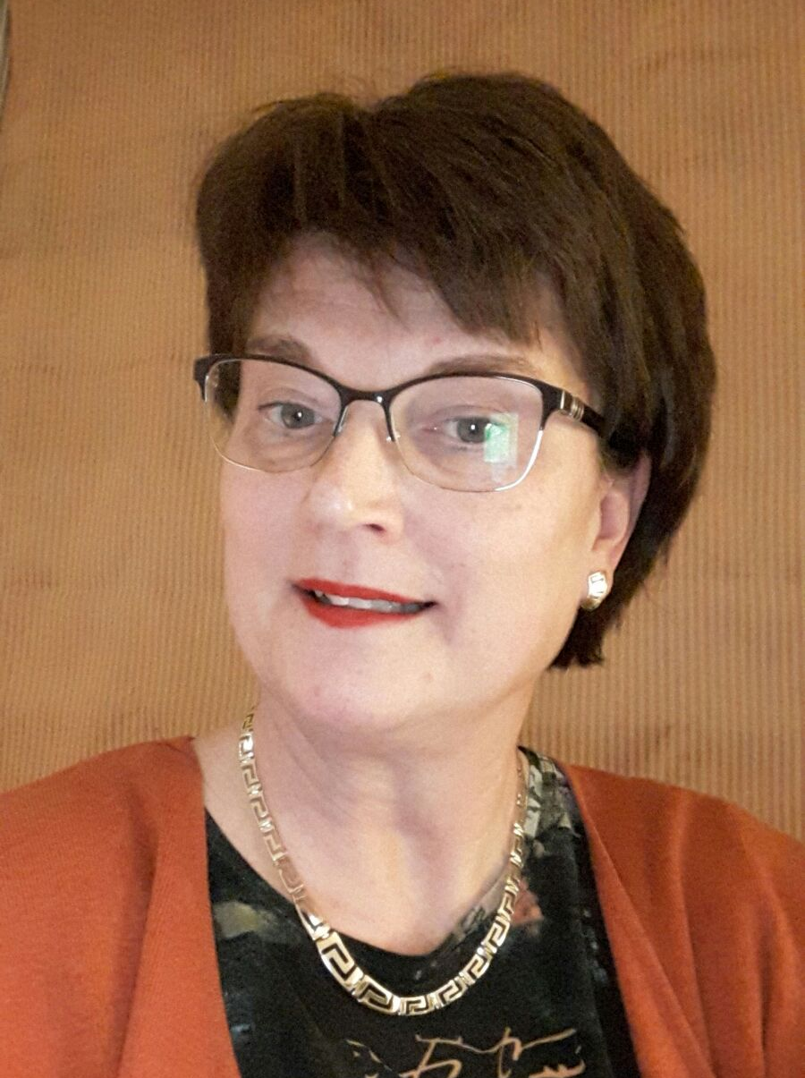
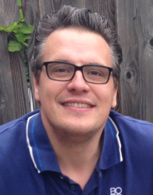
Members of the Supervisory Committee (VO)
On behalf of the employer
  Krista Keijzer
  (since 2018)
  David Hoogenraad (since 2016)

Slide 32
Annual report of the VO on 2017 (content)
Professionalization of the VO
  Full sparring (countervailing) partner
  Training (VO and professional level A)
The VO regularly consults with:
  Internal VO in preparation for a meeting with the board and other parties (5X)
  The board or a delegation (6X)
    Review the Board's decision list
    Development of the coverage ratio of the Fund
  Visitation Committee
  External auditor (draft annual report)
  Certifying actuary (concept of actuarial report)
E-Tol environment
  For the archiving of the reports, and other (study) documents

Slide 33
Annual report of the VO on 2017 (judgment)
In general, the VO is positive about the policy pursued and its implementation. The coverage ratio is good
Points for improvement regarding the actions of the Board
  Faster informing the VO about various matters
  Thinking about the Board of Supervisors, which was mandatory on January 1, 2019, too postponed
  The reappointment procedure for current members of the Board and the VO is not clear.
Good points regarding the actions of the Board
  conversion of the portfolio as a result of ALM study has been effected
  Adequately responded to AON Hewitt's sale to RiskCo
  Workshop held about mission, vision and strategy with all stakeholders
Judgment about the policy pursued
  The Board has dealt with the interest rate hedge policy very adequately

Slide 34
Activities in 2017
Interview with visitation committee (April 10)
Interview with the Certifying actuary and Accountant (May 8)
Additional courses by members VO
Consultation with representatives of the board
  Review decisions
  Discussion about interest rate swaps (to be phased out)
  Advice on the adapted communication plan
  Discussion about the Supervisory Board instead of the Visitation Committee
  Indexation (0.14% but the beginning is there)
Notes:
Deze slide kun je naar mijn mening wel weglaten omdat hij dubbelt met het VO jaarverslag op de vorige slides.

Slide 35
Preview 2018
(co-) working on the establishment of a Supervisory Board (SB) instead of the Visitation Committee
Special attention for the pending adjustments to the pension system
Continue with knowledge development members VO
Regular consultation with the PF board and discussions with the visitation committee, accountants and others

Slide 36
Summarizing
The communication between the PF board and the VO has greatly improved
In the opinion of the VO, the board is thoroughly involved and has secured professional assistance
The coverage ratio shows an upward trend. The SPTN can withstand the comparison with other funds

Slide 37
Any other business

